Slide 1

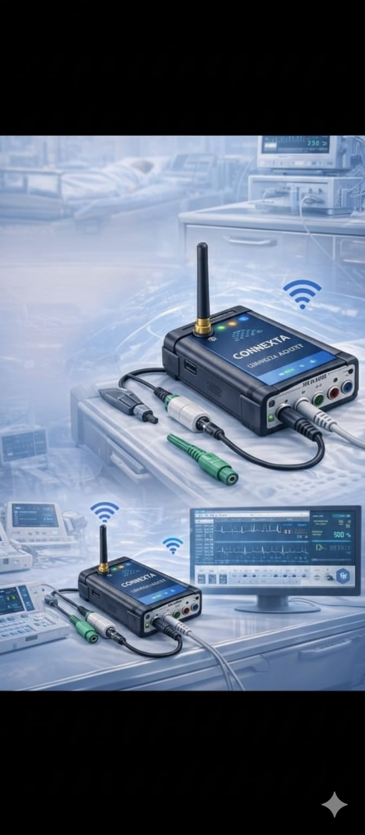
IoMT SMART SYSTEM for LEGACY MEDICAL DEVICES
Theme : Bridging Legacy Medical Devices to Smart Healthcare using IoMT
CONNEXTA

Slide 2
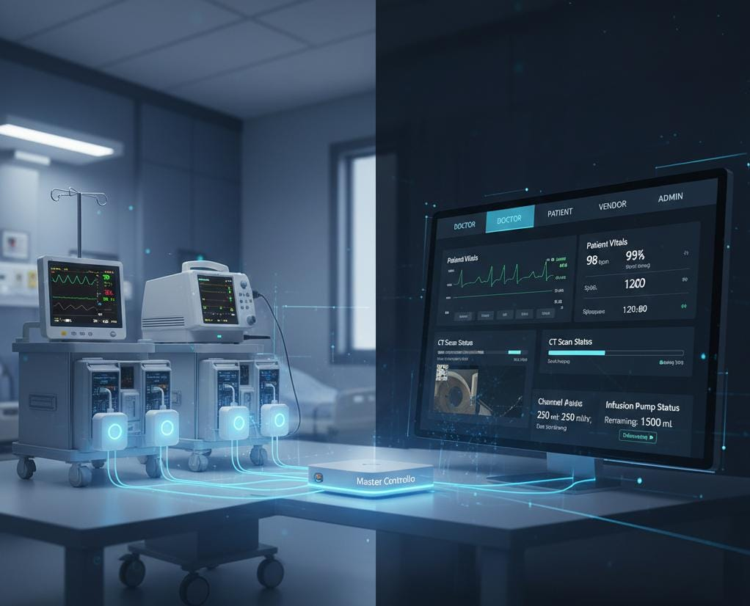
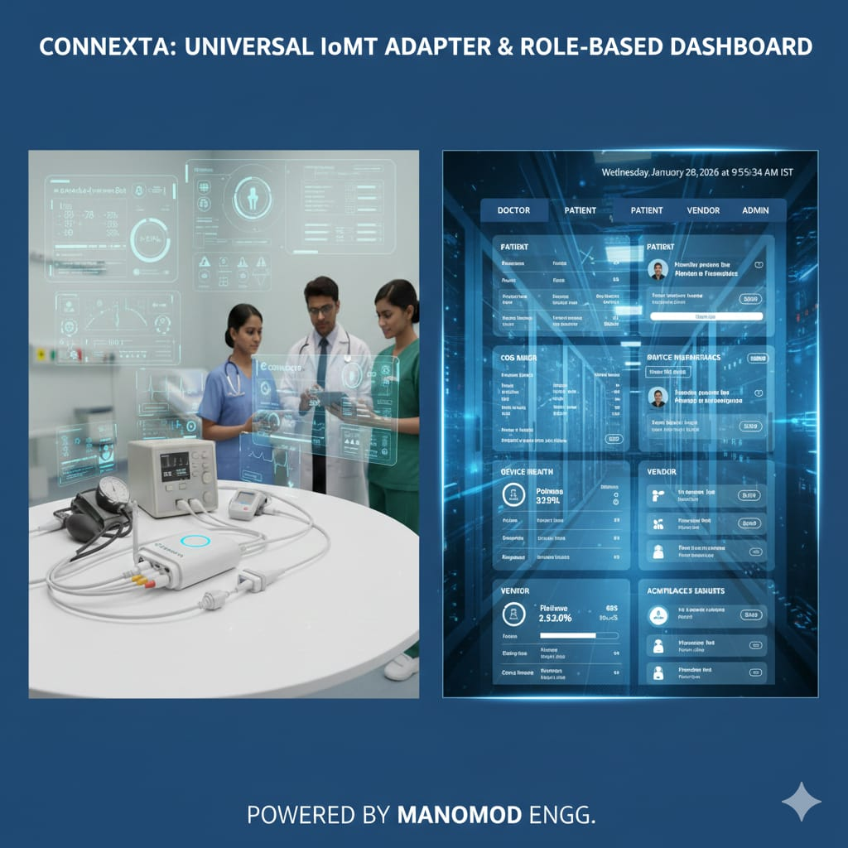
The Overview
IoMT Smart System is a plug-and-play solution designed to convert any legacy medical device into a smart IoMT-enabled device .The system uses a universal adapter and universal probe interface connected to existing medical devices, enabling real-time monitoring, EHR integration, AMC tracking, and AI-based alerts at low cost.
We are a team of biomedical engineering students developing a universal, low-cost IoMT solution that upgrades legacy medical devices without replacing them, improving patient safety, hospital efficiency, and digital healthcare adoption.
Connexta
Our solution avoids replacing costly smart medical devices by using low-cost universal adapters for existing legacy equipment, where multiple adapters connected to different devices communicate wirelessly with a single Master Controller.
LEARN NOW

Slide 3
The Problem
We are addressing the lack of connectivity and standardization in legacy medical devices, which forces hospitals to rely on manual data handling, leading to safety risks and inefficiencies. Since replacing existing devices with smart equipment is costly, hospitals struggle with real-time monitoring and effective maintenance, making this a real and widespread problem.
Customer Pain
Persona (Target Customer)
Multiple legacy devices from different manufacturers
Different probes & outputs → no standardization
Manual monitoring causes errors & delays
No centralized real-time monitoring system
No device health or usage tracking
Replacing devices is costly & impractical
Multi-specialty hospitals and clinics
Rural and urban hospitals and clinics
ICUs, emergency wards, and general wards, ect...
Doctors, biomedical engineers, AMC / service vendors , patient's and hospital administrators
💰🏥 High cost to buy new machines
🤖❌🚨 No AI alerts
💸🛠️ Costly AMC service
❤️‍🩹❌ No device health tracking
📡❌ No real-time data
🗂️🔗❌ Scattered EHR
✍️📋 Manual monitoring
LEARN NOW
⏳⚙️
Old medical devices
healthcare needs a smarter fix 🧠⚕️

Slide 4
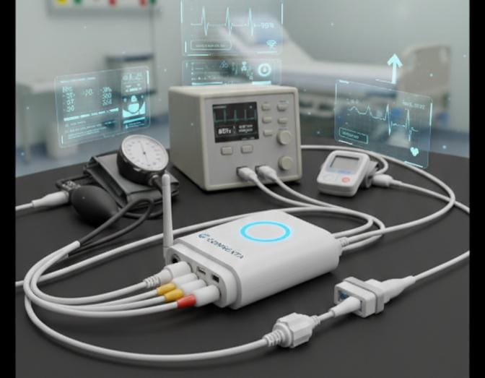
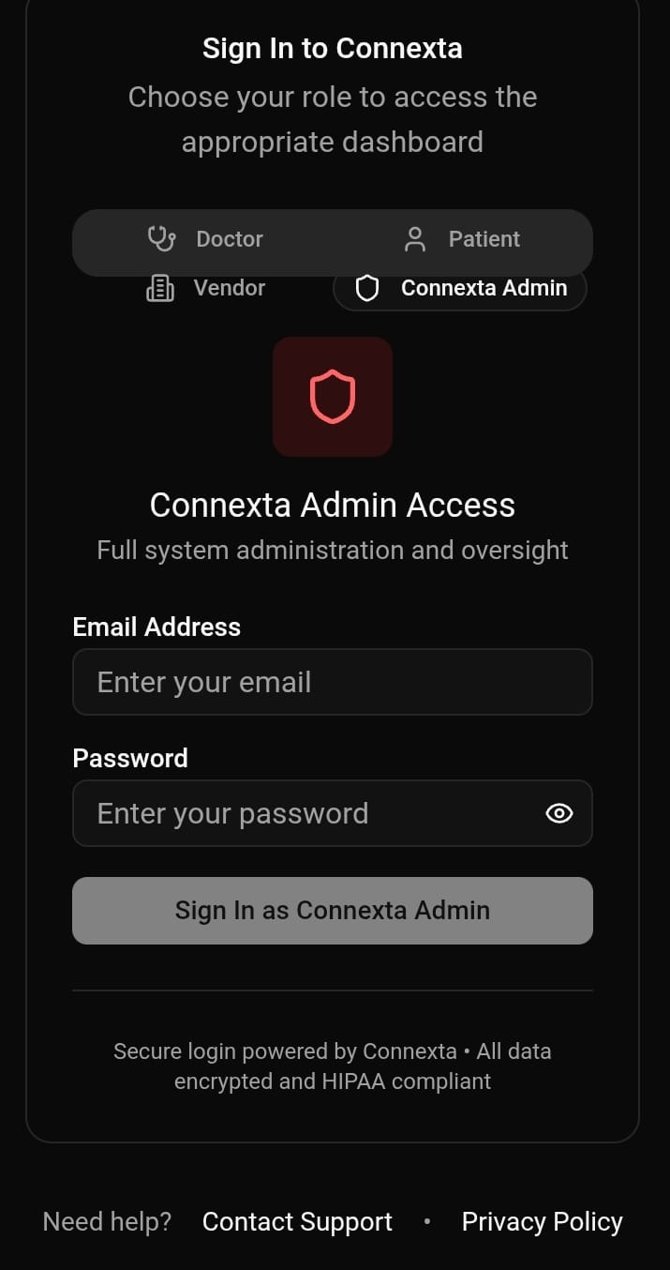
The Solution
We address the problem by attaching a universal smart interface to existing medical devices, converting them into connected systems. Data is centrally processed by a master controller and delivered as secure real-time insights, EHR updates, and maintenance alerts through a controlled dashboard.
Universal solution for the entire hospital
Eliminates device-specific adapters
Reduces cost and complexity
Secure and scalable architecture
Easy to deploy without disrupting hospital workflow
Ideal for Indian healthcare infrastructure
Converts any legacy medical device into a smart IoMT device
Uses a fixed universal probe solution for standardization
One Master Controller manages multiple devices simultaneously
Enables real-time patient monitoring
Automatically updates Electronic Health Records (EHR)
Allows AMC vendors to monitor device health and usage
Why it’s compelling ?
What the Innovation Does ?
TRY IT!
Website link: https://manomedengg.github.io/Conexta/
LEARN NOW
Take a
Look

Slide 5
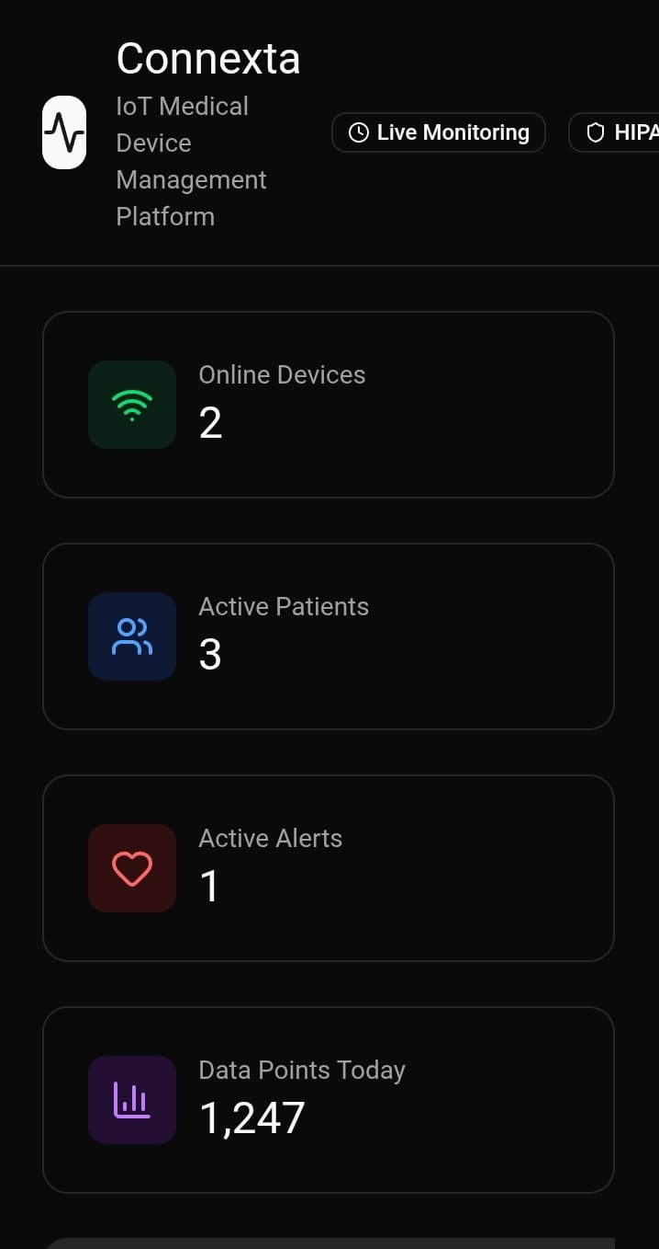

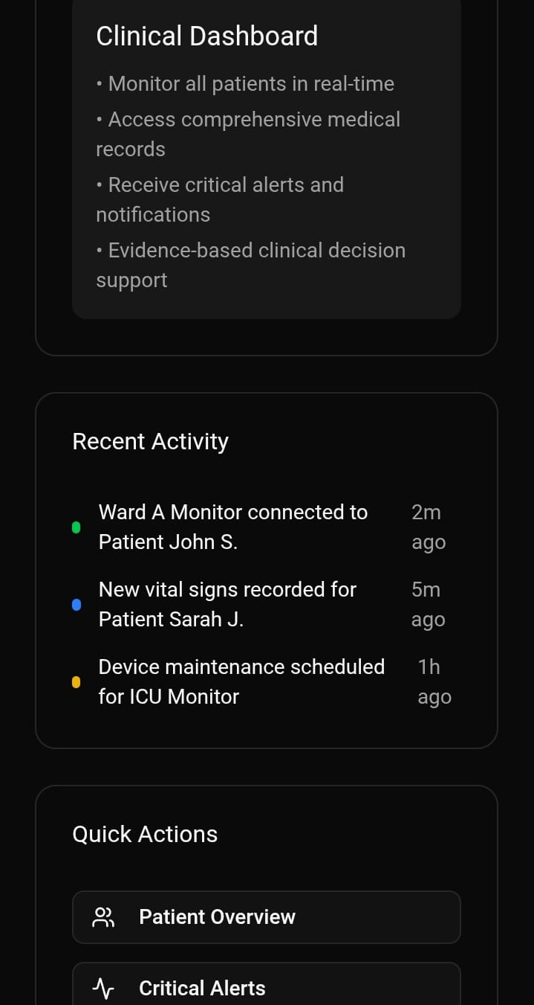
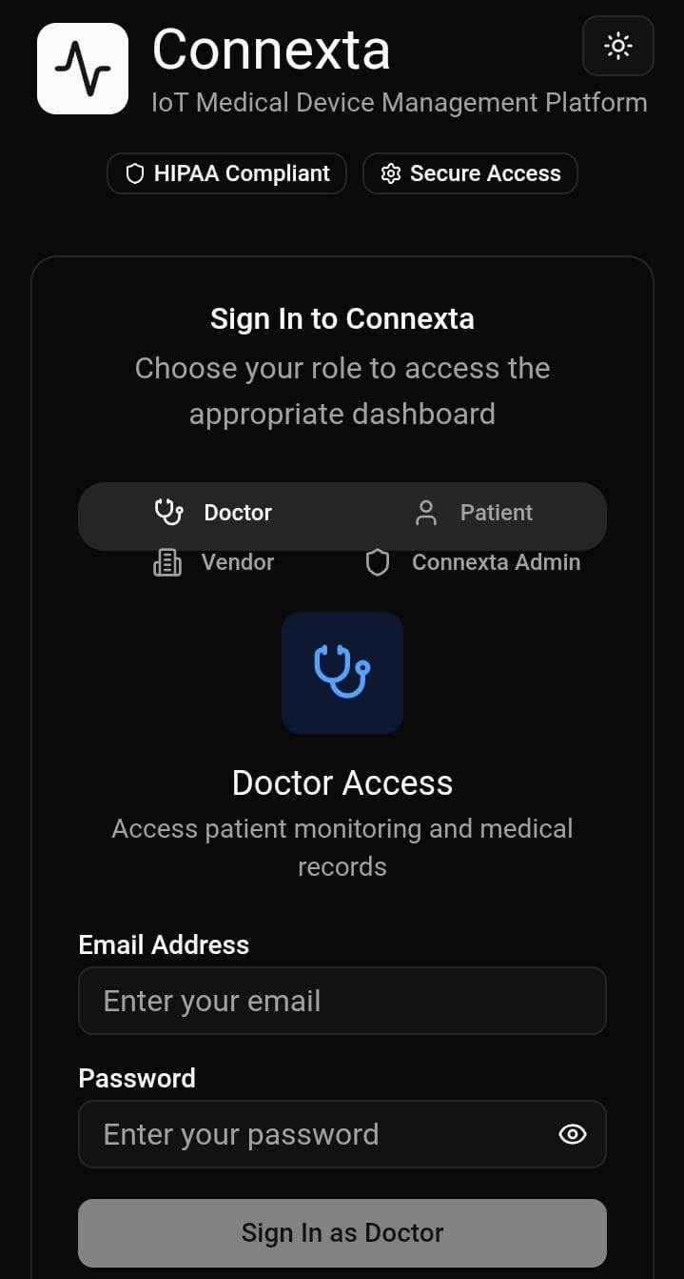
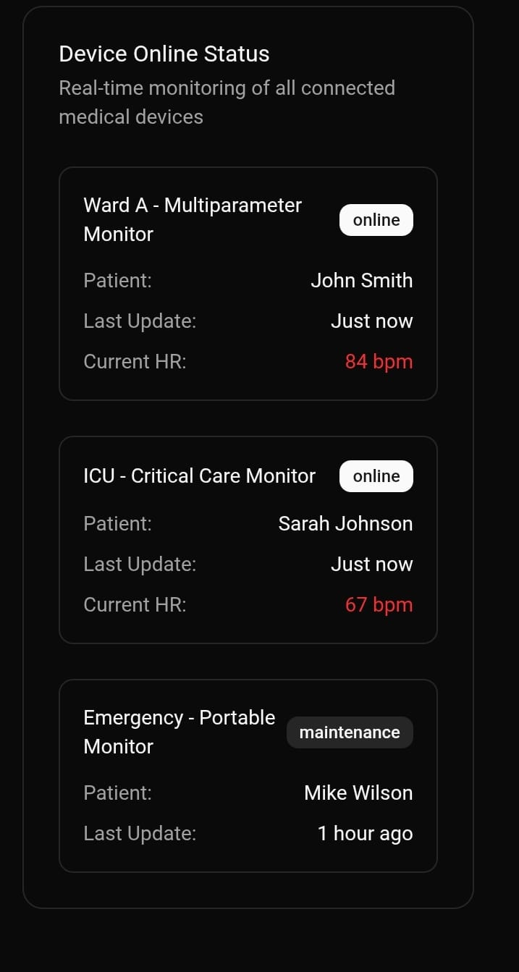
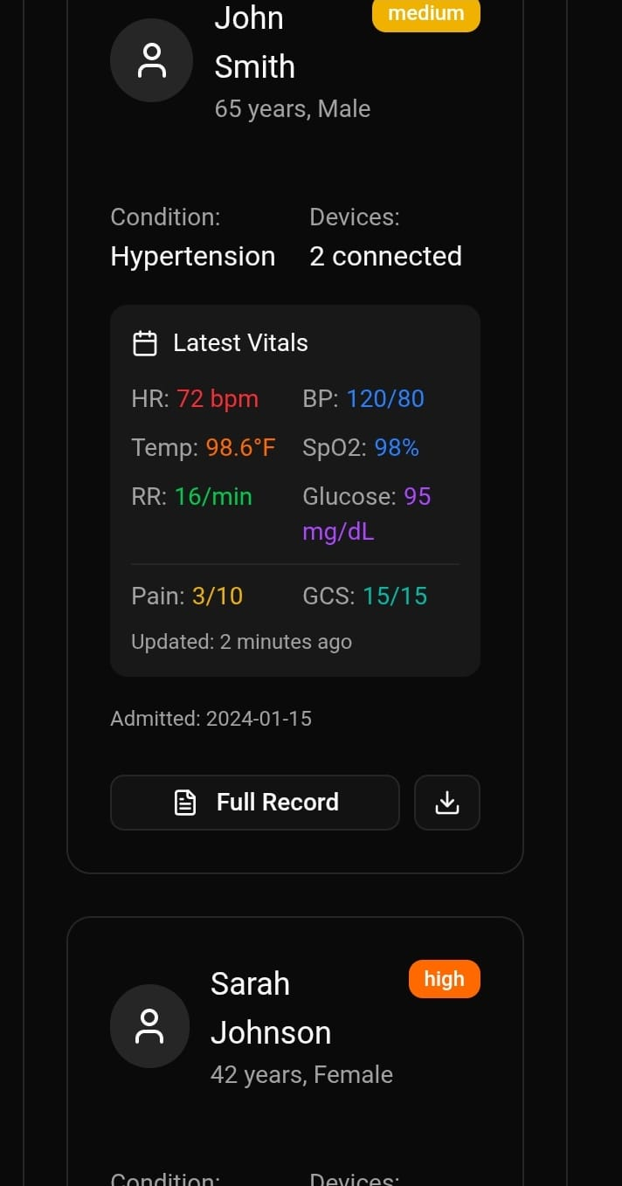
The innovation
Value Proposition of the Product
Value Proposition of the Product
Benefits/Impact
Benefits/Impact
Low-cost IoMT upgrade for legacy medical devices without replacement
Compact and space-efficient design, suitable for any clinical setup
Portable and easy to carry, enabling flexible deployment
Universal solution compatible with multiple device types and manufacturers
Centralized control using a single master controller architecture
Reduces hospital expenditure on new smart devices
Saves clinical space compared to bulky monitoring systems
Enables quick installation and relocation across departments
Simplifies hospital digitization with one common platform
Improves operational efficiency and patient care quality
Click The Video
LEARN NOW

Slide 6
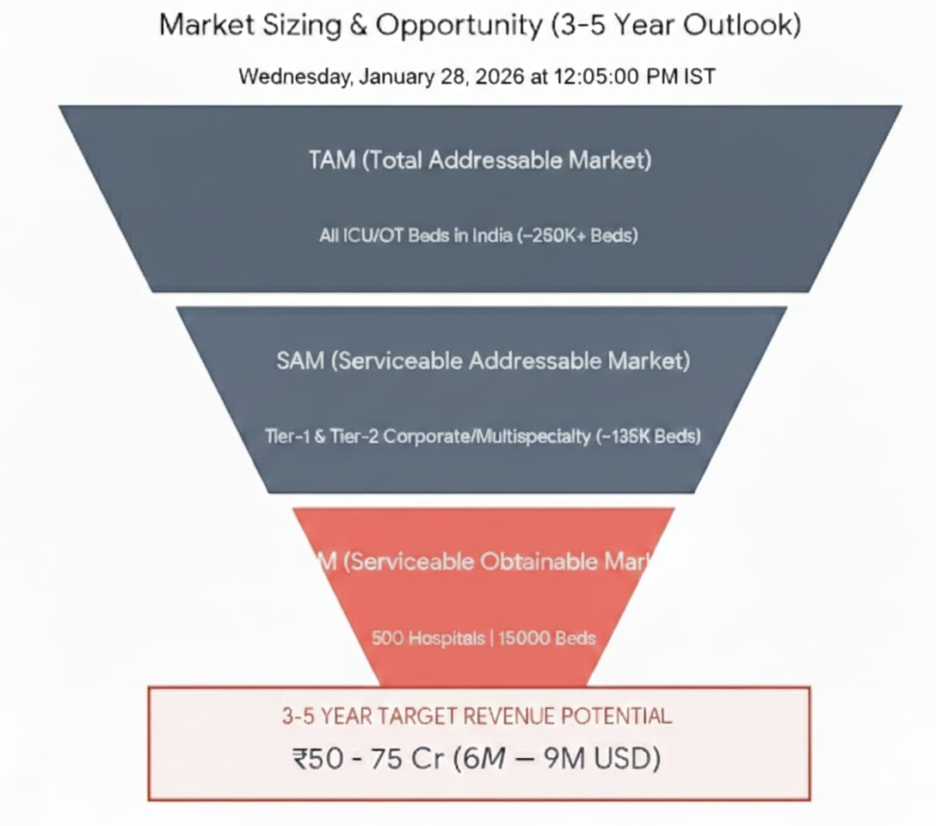
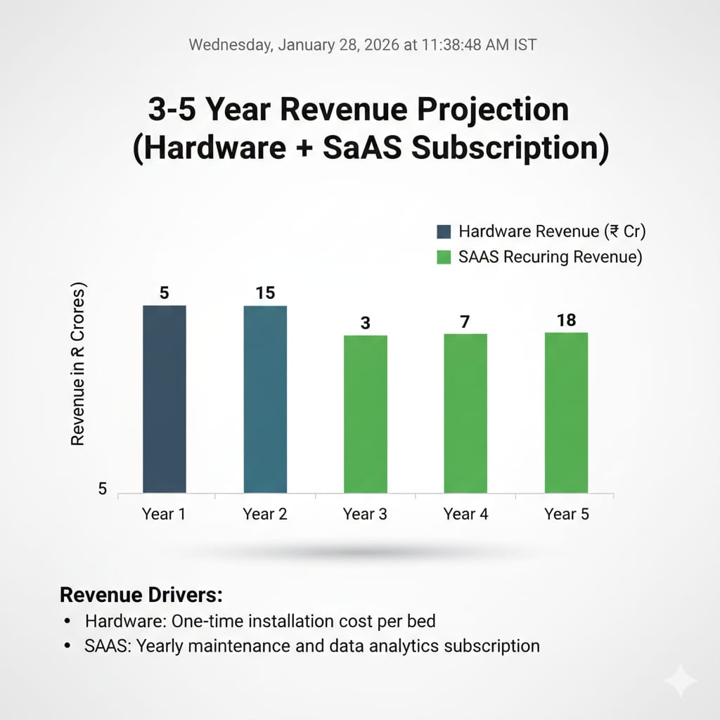
Market & Opportunity
TAM (Total Addressable Market)
Definition: All monitored beds (ICU, OT, HDU, step-down) across India requiring vitals connectivity.
Scale: ~390,000 beds across 54,000 hospitals in India.
Market Potential: Entire Indian hospital ecosystem needing real-time EHR integration, device connectivity, and centralized AMC monitoring.
Value Opportunity: ₹14,000–20,000 crore (5–7% of global IoMT connectivity market).
SAM (Serviceable Available Market)
Definition: Digitization-ready hospitals (have HIS, Wi-Fi, IT infrastructure) with monitored ICU/OT beds.
Scale: ~260,000 beds across ~5,000+ hospitals (Tier-1 corporate + Tier-2 multispecialty + teaching hospitals).
Focus: Hospitals with budget and readiness for digital health adoption; legacy devices needing EHR bridge.
Value Opportunity: ₹1,500–4,000 crore over 5–7 years (hardware + SaaS license model).
LEARN NOW

Slide 7
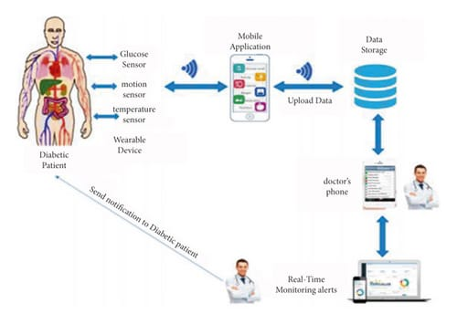













The Technology/Innovation
Technology Readiness Level (TRL)
Software/Firmware: Embedded C++ for device firmware, Python for data processing. Uses MQTT protocol for secure, lightweight data transmission.
Cloud Platform: Nextcloud or Cloudstack for scalable data ingestion.
Frontend: A web-based dashboard using React/ Typescript to display real-time and historical patient data
Backend: API layer for Authentication & logic
Functional prototype validated through simulations and software models. Core features like data acquisition, cloud integration, and AI alerts are tested in a controlled environment, with hardware integration planned as the next phase.
Software/Firmware
Cloud Platform
Data Base
Frontend
Backend
Mobile Application
LEARN NOW

Slide 8
Competitive Landscape
Our Innovation:
AI-assisted protocol translation for legacy devices
Edge buffering for wireless stability in hospital EMI
Real-time EHR integration + clinical alerts
Vendor dashboard for AMC tracking & predictive maintenance
Market Advantage:
Cost-effective retrofit for millions of legacy devices
Enables rural hospital connectivity
Reduces vendor downtime & service costs by 20–30%
Competitors:
Philips Monitoring Systems (high-cost device replacement)
GE Healthcare CapnoBase (proprietary connectors)
Siemens SIMATIC HMI (requires custom configuration)
Hospital IT custom solutions (expensive, non-scalable)
Connexta's Competitive Advantage:
Universal adapter for ANY legacy probe
Plug-and-play (no device replacement)
10x cheaper than new monitors (₹40–50k vs ₹5–20 lakhs)
Works with any hospital HIS/EHR
Vendor device health monitoring + predictive maintenance
Barriers to Entry:
Complex device protocol expertise
Regulatory compliance (HIPAA, IEC-60601)
Hospital trust & credibility
Partnership Opportunities:
Hospital IT teams (integration services)
Device manufacturers & AMC vendors
EHR vendors (Epic, Medidata, Zoho)
Biomedical dealers (channel partnerships)
Research institutions (validation studies)
LEARN NOW

Slide 9
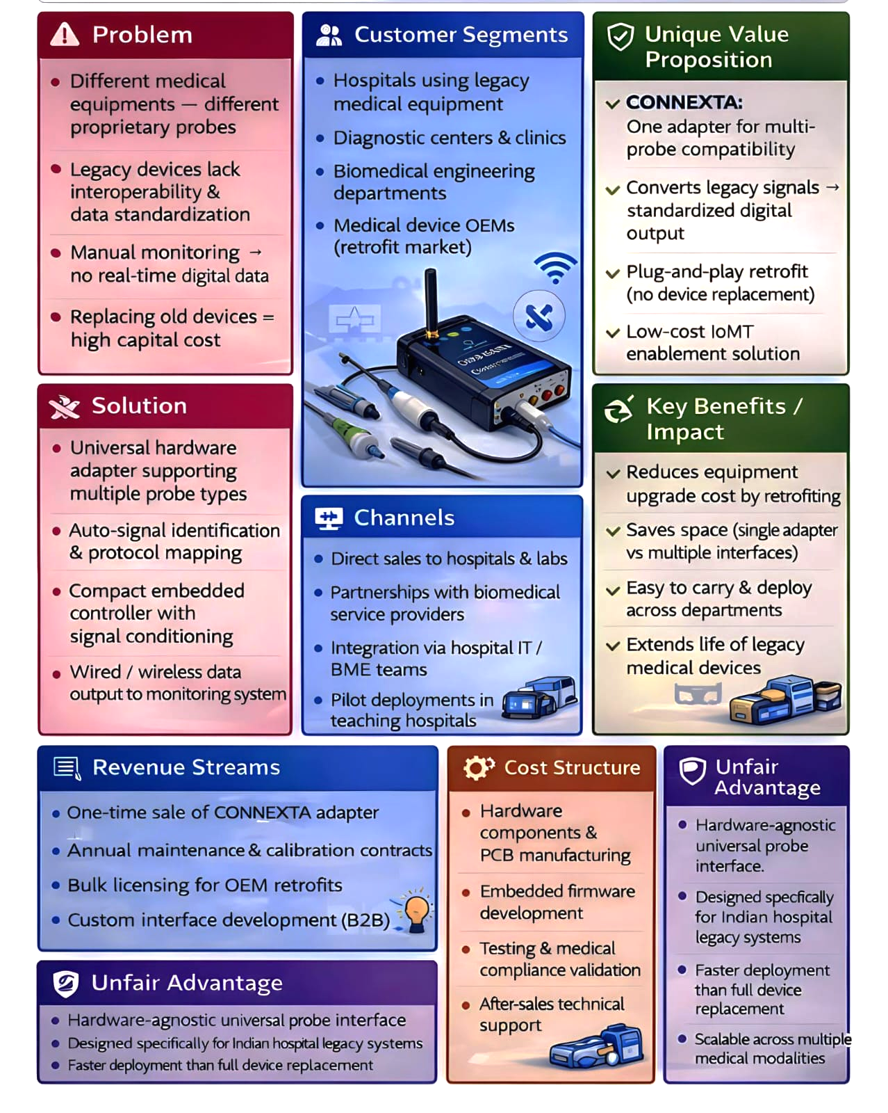
LEAN CANVAS
LEARN NOW

Slide 10
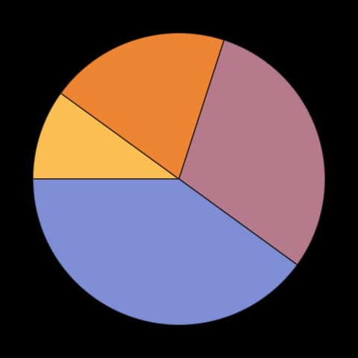
Business Model
Timeline | Milestone
0-6 Months | Product development & regulatory pre-compliance
3 - 6 Months | Beta pilot with 2–3 tier-1 hospitals; proof of concept
6 - 12 Months | First commercial orders & EHR integrations live
12 - 18 Months | Scaled rollout to 10–15 hospitals; vendor partnerships
18 - 24 Months | Revenue ramp-up; 50+ hospital deployments; AMC contracts
Hardware: IoT Gateway sells at ₹40–50k/unit for bedside deployment
Service as a System: EHR integration + dashboard subscription at ₹3–5k/bed/month generates reacurring revenue
Services: Hospital integration & customization fees at ₹5–10 lakhs/hospital
B2B Partnership: Licensing to device manufacturers and EHR vendors at ₹50–100 lakhs/year per partner
SaaS: 60% (₹90 Cr ARR)
Hardware: 25% (₹35 Cr)
Services: 10% (₹15 Cr)
B2B: 5% (₹10 Cr)
Connexta captures ₹200–500 Cr (10–12% share).
Why Viable:
Hardware: One-time low capex → quick revenue
SaaS: High-margin recurring (70–80%)
B2B: Strategic partnerships → scale without sales team
Total: Predictable cash flow from Day 1 pilots
SAM Penetration: ₹1,500–4,000 Cr over 5 years → Connexta
captures ₹200–500 Cr (10–12% share).
Services
LEARN NOW
B2B
Hardware
Service as a System

Slide 11
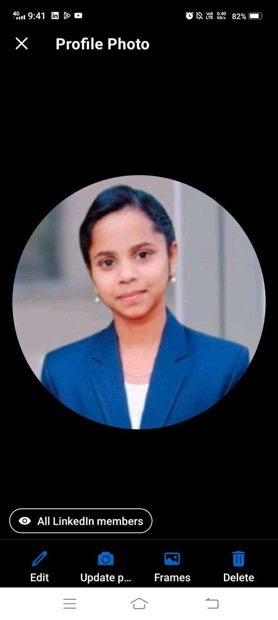
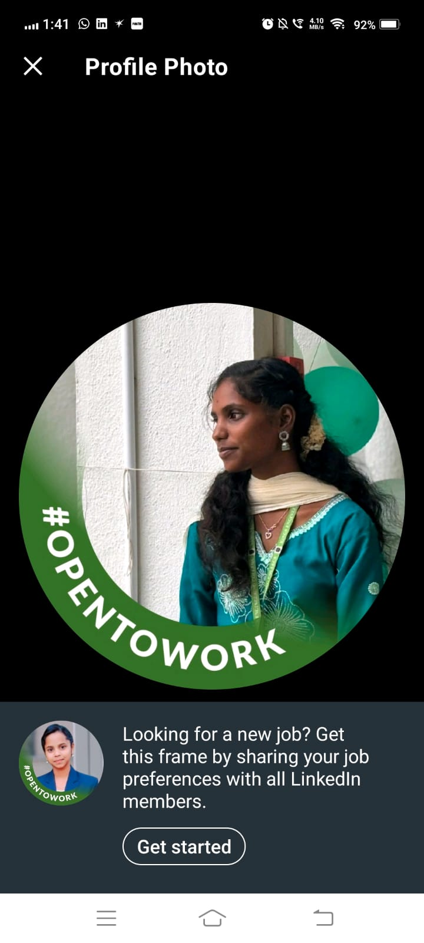
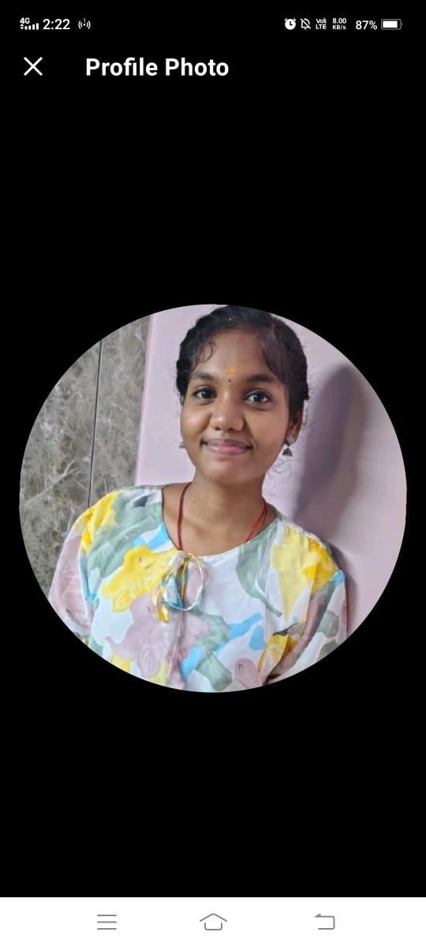
The Team
Shankari S - Second Year Biomedical Engineering
Android/Web app developer, UI/UX for healthcare , Bluetooth integration, real-time dashboard design
Frontend Developer & UI/UX
Vedhavalli V - Third Year Biomedical Engineering
ESP32 + sensor integration, Builds wearable hardware, MATLAB signal processing
Product Lead & Hardware
Swathi Priya S - Third Year Biomedical Engineering
Firmware + Bluetooth connectivity , IoT platform development, production-ready embedded systems
Embedded Systems
Unique Value Each Brings:
Biomedical domain knowledge + hands-on prototype experience
Full-stack development (hardware → cloud → mobile app)
Real-world hospital problem solving
LEARN NOW

Slide 12
Thankyou

